Slide 1

JSS ACDEMY OF TECHNICAL EDUCATION,NOIDA web development presentation topic: food ordering website
Under Guidance Of Mr. Ajay Kumar Indoria
Submitted by: Harsh kedia
1809113051
Ghanshyam pal
1809113048

Slide 2
INTRODUCTION
Just Eat is an online food ordering website that deals with ordering, Processing and delivering food products.
Ordering is done by a Valid Customer with an appropriate identity and address.
The administration receives order, acknowledges the customer, process them and assures delivery at your doorstep.

Slide 3
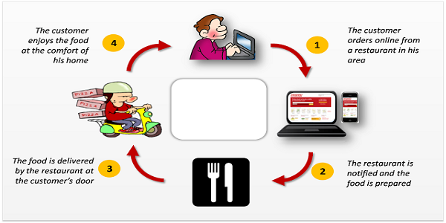
What We Will Do:

Slide 4
Food Ordering System Module:
Create an account
Log in to the system
Select food items from the menu
Review their current order
Provide payment details
Place your order
Receive confirmation in the form of order number
Your food will be deliver shortly
Enjoy your meal.

Slide 5
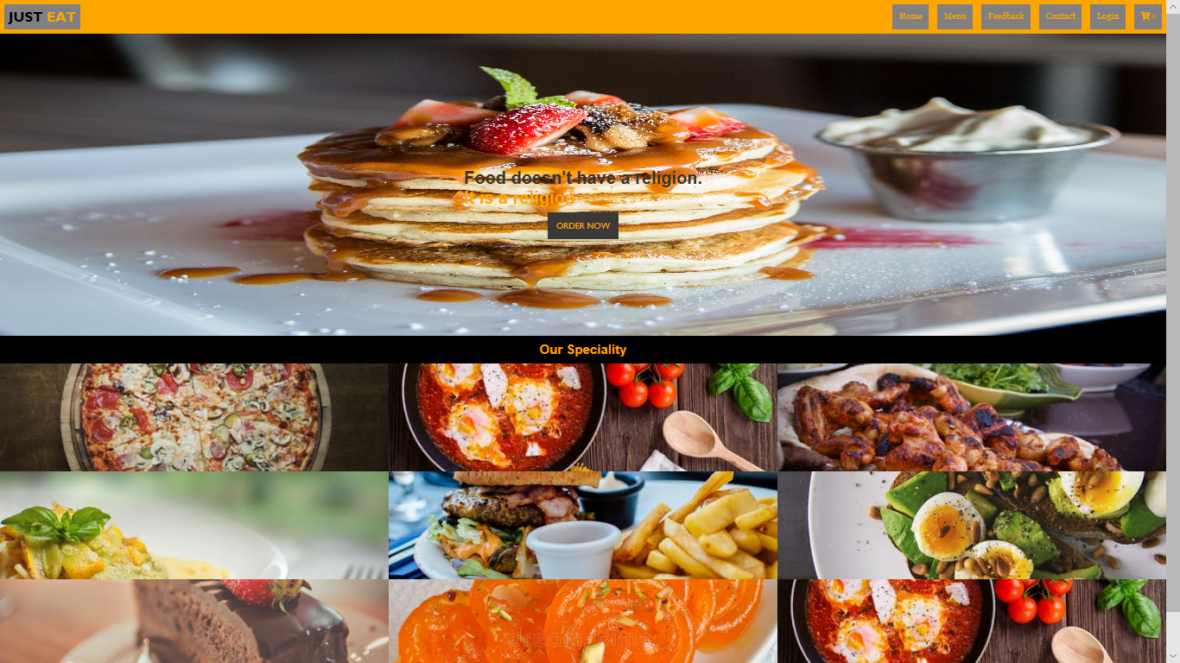
HOME PAGE:

Slide 6
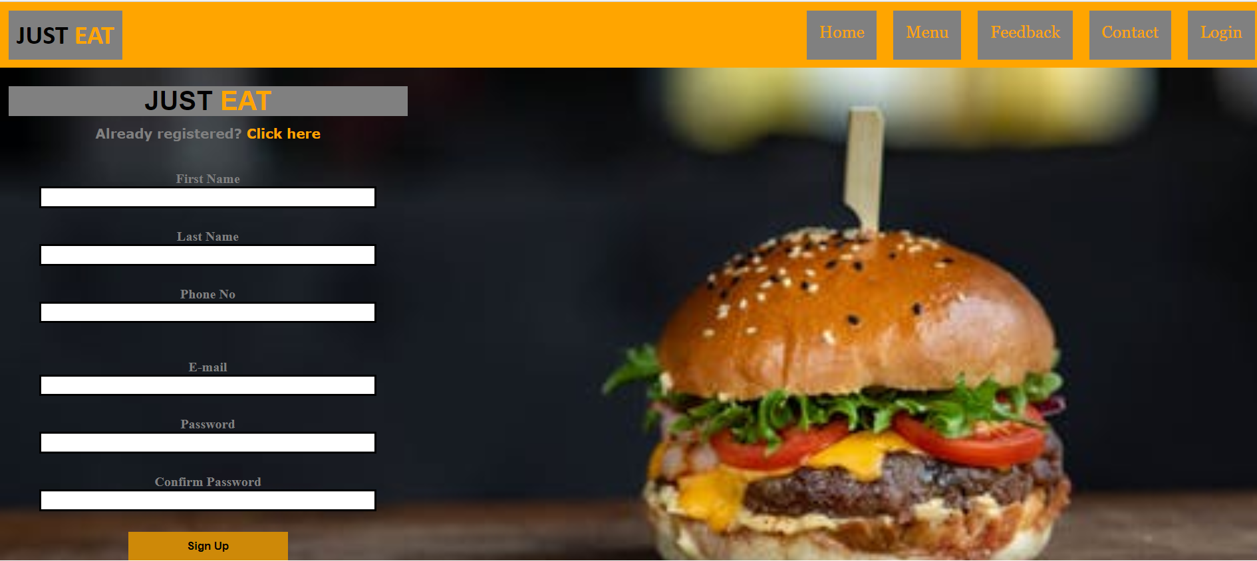
SIGN UP/LOGIN PAGE:

Slide 7
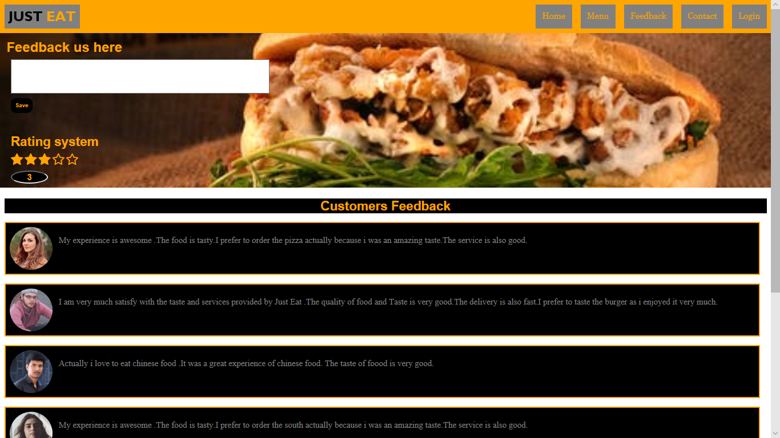
FEEDBACK:

Slide 8
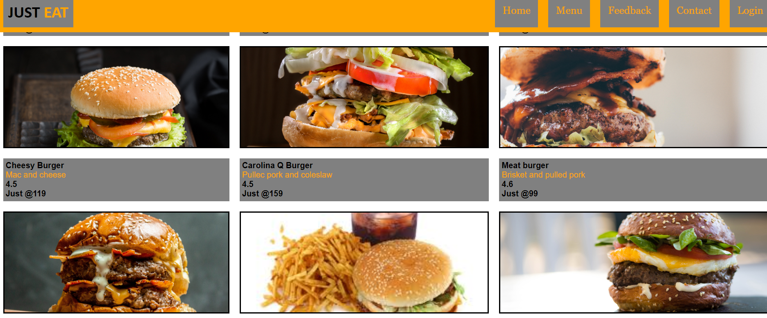
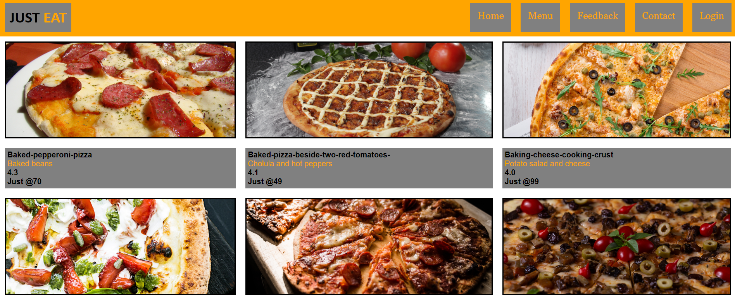
FOOD MENU:

Slide 9
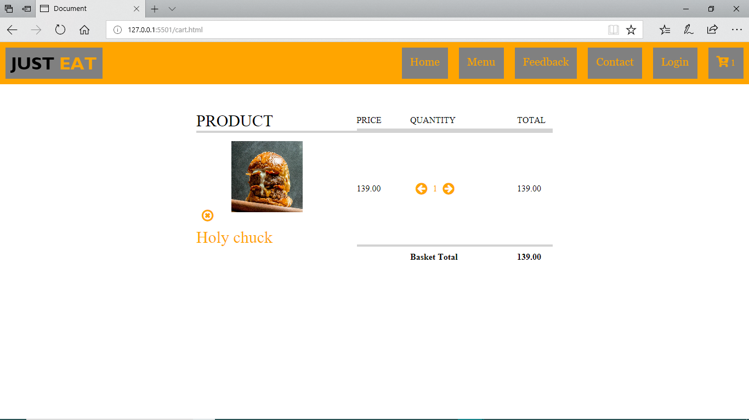
CART VIEW:
Review your order in the cart and finally place the order

Slide 10
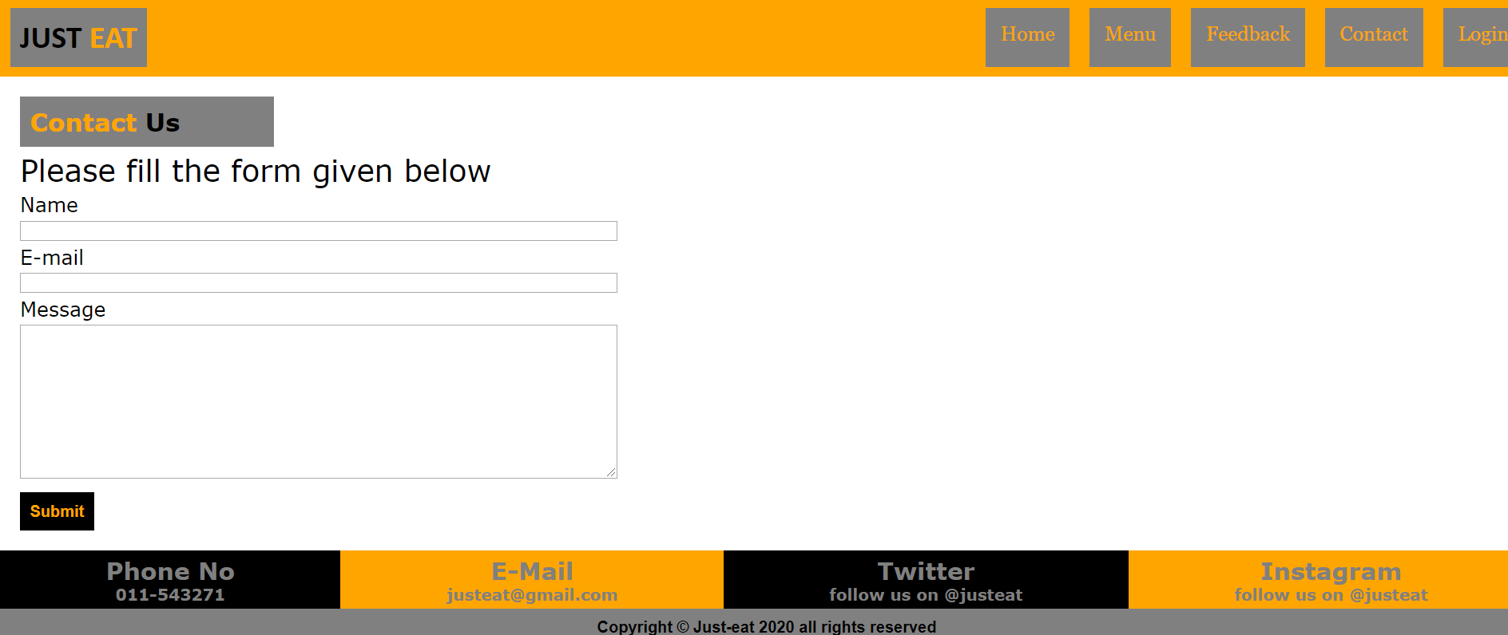
CONTACT US:
For any issues you can fill the above form to get in touch with us.

Slide 11

Additional Information:
Food as per your mood
Simple Ordering
New features are added regularly
Log in with your account and reorder easily
Freebies, Cashbacks, Offers and Discounts.

Slide 12

!!THANK YOU!!

